Slide 1
TELECOM - CUSTOMER CHURN
PROJECT 162 - GROUP 6
Mentor - Bapuram Pallavi

Slide 2
OUR TEAM
Vijaykumar Rewate
Akash Marthandrao Dhond
Sriprakash L
Rajshri Narsing Ekbote
Emmanuel Clement Anthony
Nakil Srushti Prashant
Krishnaraj K

Slide 3
CONTENTS:
Introduction
Objective
Data Collection
Exploratory Data Analysis
Feature Engineering
Feature Selection
Model Building
Hyper Parameter Tunning
Deployment

Slide 4
INTRODUCTION:
The global telecommunications market is continually transforming on account of the ongoing innovation and developments taking place consistently and at a first pace. So for the growth of telecommunication market the loyalty of the customer is key factor.
In media transmission worldview, Churn is characterized to be the movements of clients leaving the organization and disposing of the administrations offered by it because of disappointment of the administration as well as because of better offering from their system suppliers inside the reasonable sticker price of the client. So holding of the client is exceptionally troublesome.
Hence it is gradually important for telecommunication companies to proactively identify factors that tendency to unsubscribe to take preventive measures to retain customers.

Slide 5
OBJECTIVE
Customer churn is a big problem for telecommunications companies. Indeed, their annual churn rates are usually higher than 10%. For that reason, they develop strategies to keep as many clients as possible.
This is a classification project since the variable to be predicted is binary (churn or loyal customer).
The goal here is to model churn probability, conditioned on the customer features.

Slide 6
Data Collection

Slide 7
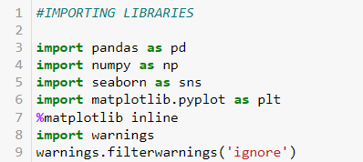
Libraries :
Matplotlib is a python Pandas is open score python library that
provides high-performance ,easy-to-use
structures and data analysis tools also
provides several methods for reading
data in different formats.
Numpy provides a high-performance multidimensional
array and basic tools to compute with and manipulate these arrays.
Seaborn provides high-level commands to create a variety of plot types useful for statistical data
exploration, and even some statistical model fitting.
library used to create 2D graphs and plots by using python scripts.

Slide 8
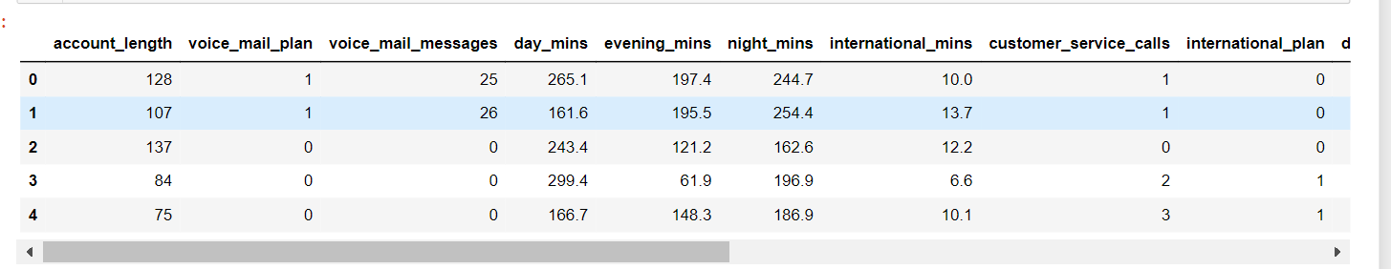
Overview of dataset:

Slide 9
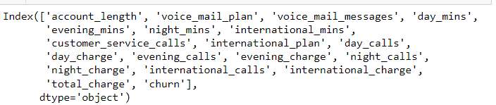
Variable Description:
Voice_mail_plan-
Data informs whether customer
Has voice mail plan or not
Day_mins -
Call minutes during daytime for a customer.
Churn –
It shows whether customer has continued or cancelled the subscription .”0 ” indicates continuation
Of subscription and “1” indicates cancelling of subscription

Slide 10
Exploratory Data Analysis

Slide 11
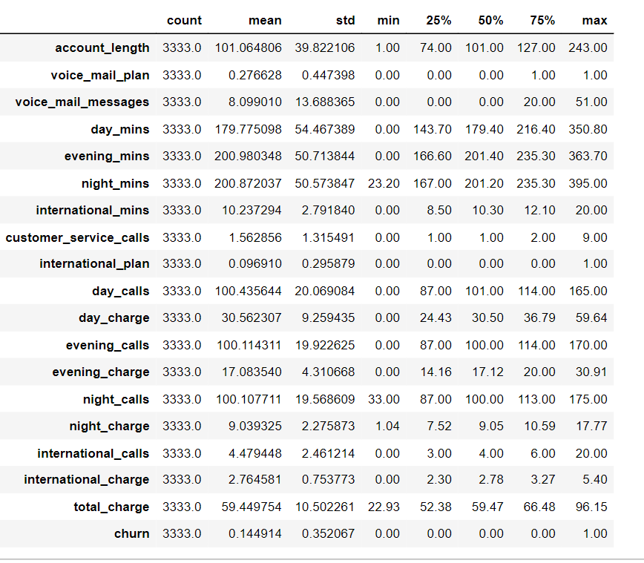
Statistical Summary:

Slide 12
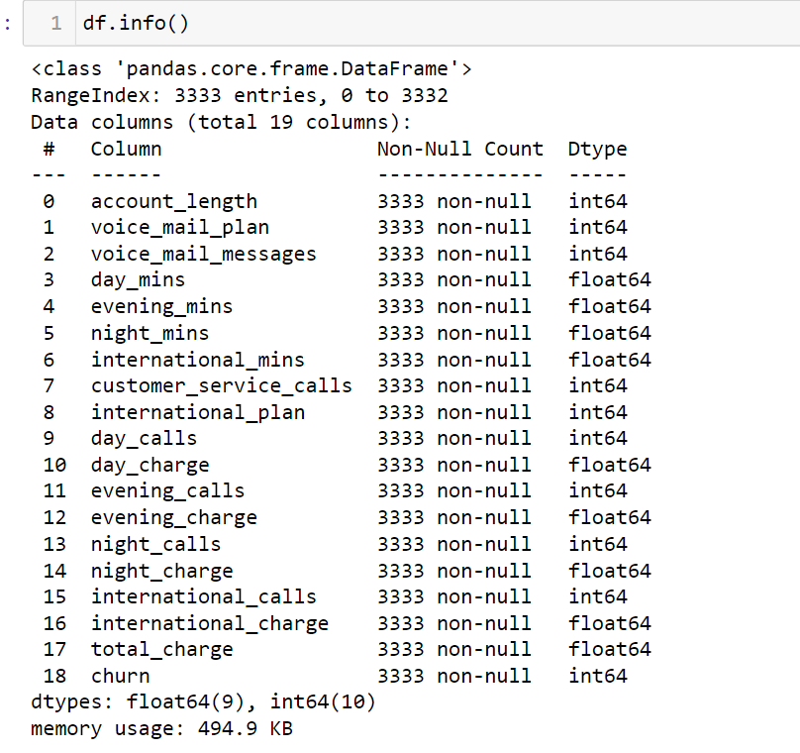
Null Values:
There is 3333 observation in
Dataset
There is 30 columns in dataset.
There is no null values in dataset

Slide 13
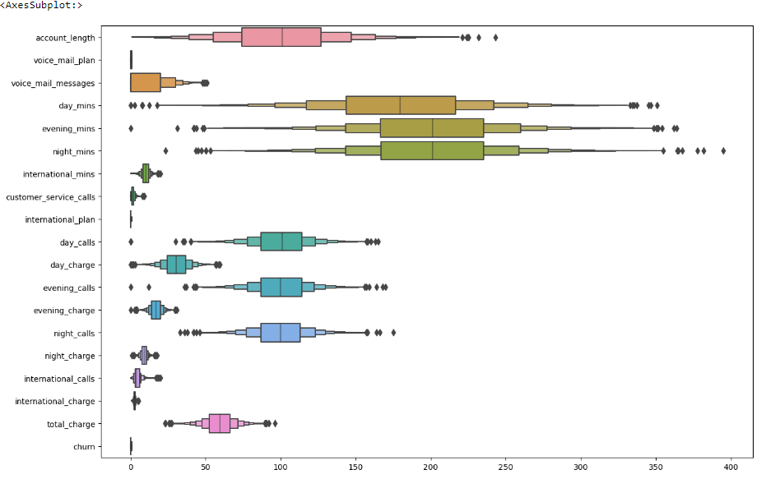
Boxplot is created to display summary of the set of datavalues.
Boxplot helps to define outliers.

Slide 14
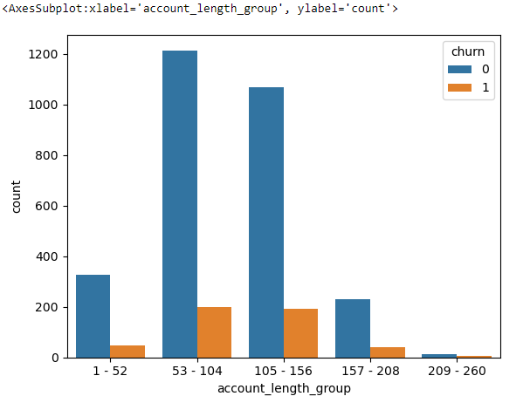
Count Plot shows the observation in each categorical bin using bar graph.
Account_length has been grouped in bins of 52 weeks.
Group 2 and Group 3 has more number of churns.

Slide 15
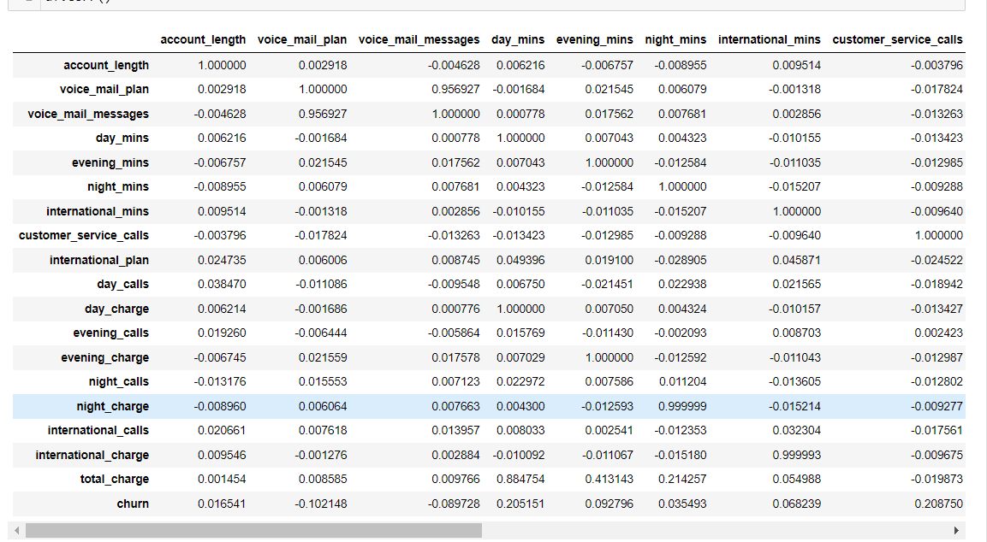
Correlation between variables:

Slide 16
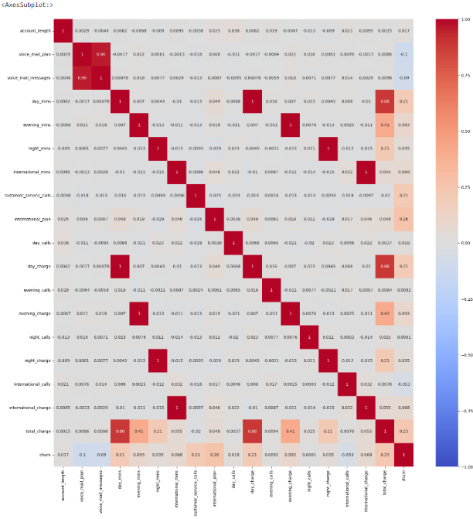
A heatmap contains values representing various shades of the same colour for each value to be plotted.
Heatmap shows the correlation between data.
Charge and minutes has more correlation.

Slide 17
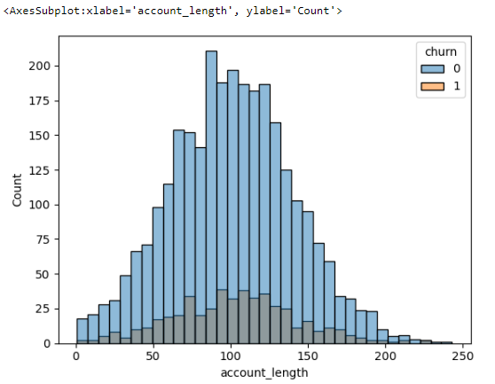
Histogram allows you to see the frequency distribution of a data set.

Slide 18
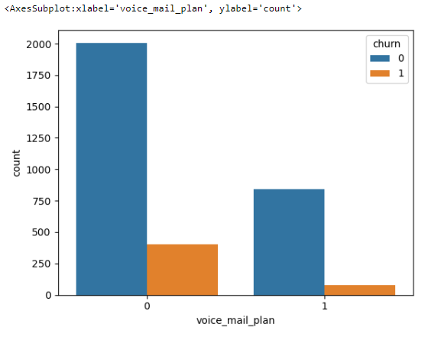
This plot shows customers without voicemail plans are churning.

Slide 19
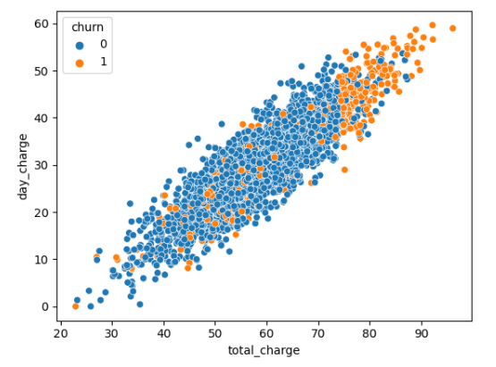
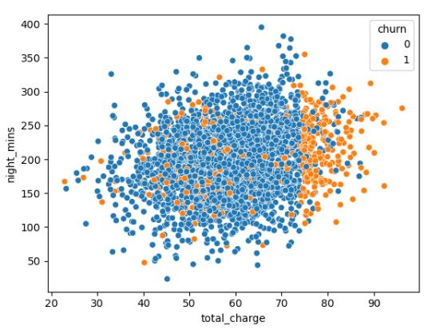
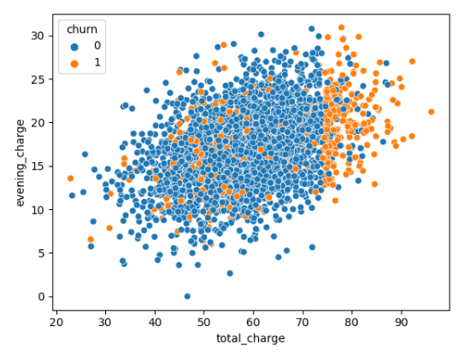
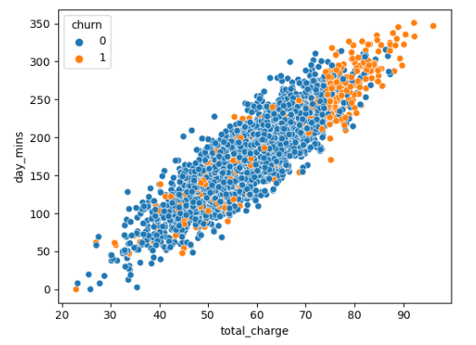
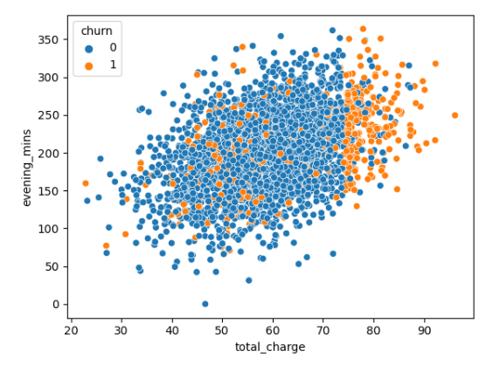
Scatter plots are the graphs that present the relationship between two variables in a data-set.
Slide shows some scatter plots of total charge vs different minutes and charges.

Slide 20
Feature Engineering

Slide 21
Handling the Imbalanced Data Set-
LogisticRegression Classifier :
Logistic regression is an example of supervised learning . It used to calculate or predict the probability of binary(yes/no) event occurring.
GaussianNB Classifier :
Naïve Bayes classifers are a collection of classification algorithms based on bayes’ theorem . It is not a single algorithm but a family of algorithm where all of then share a common principle
Naïve bayes often used in sentiment analysis ,spam filtering , recommendation system.
3)KNN Classifier:
K-NN algorithm assumes the similarity between the new case/data and available cases and put the new case into the category that is most similar to the available categories.

Slide 22
4) DecisionTree Classifier:
The main benefits of using a decision tree is its simplicity as the decision-making process is easy to visualise and understand .
Decision tree help you to evaluate your options
5)Random forest Classifier:
Random forest is a supervised learning algorithm is used in classification and regression problems, it builds trees on different samples and takes their majority vote for classification and average in case of regression.
6)LinearSVC:
The objective of a Linear SVC (Support Vector Classifier) is to fit to the data you provide, returning a "best fit" hyperplane that divides, or categorizes, your data.

Slide 23
7) XGBoost Classifier:
XGBoost stands for Extreme Gradient Boosting, is a scalable, distributed gradient –boosted decision tree.
It provides parallel tree boosting .It uses more accurate approximations to find the best tree model.

Slide 24
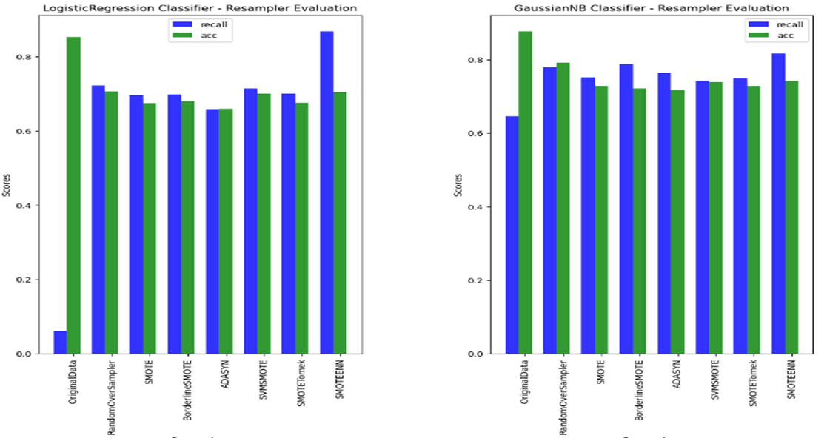
Handling the Imbalanced Data Set–
Performance of Various Imbalanced Data Handling Technique with Different Classifiers

Slide 25
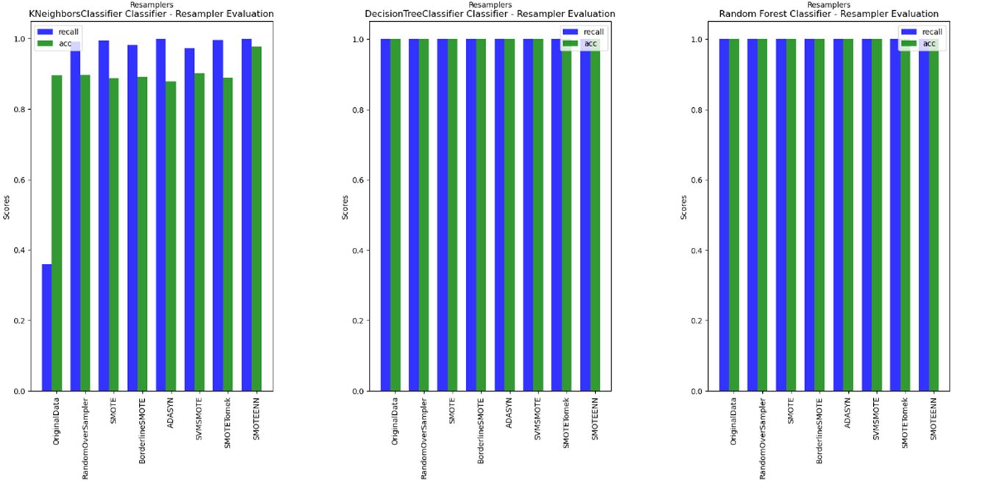
Performance of Various Imbalanced Data Handling Technique with Different Classifiers

Slide 26
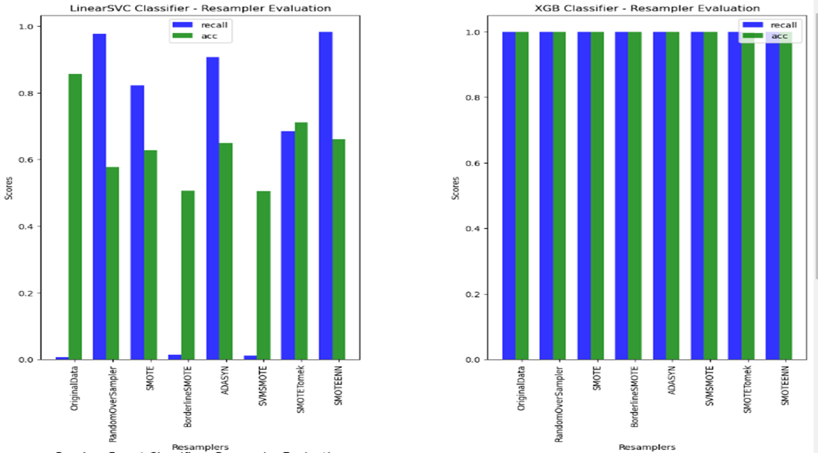
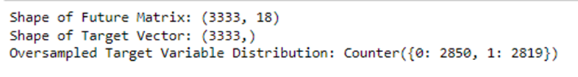

Selected ADAYSN resample technique to handle imbalance dataset

Slide 27
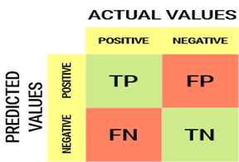
Model Evaluation
v Confusion Matrix
v Precision
v Recall
v Accuracy
v F1 Score
v AUC
v ROC
q CONFUSION MATRIX
A Confusion matrix is an N x N matrix used for evaluating the performance of a classification model, where N is the number of target classes. The matrix compares the actual target values with those predicted by the machine learning model.
T P - True Positive
T N - True Negative
F P - False Positive
F N - False Negative

Slide 28
Precision tells us how many of the correctly predicted cases actually turned out to be positive.
q Precision
Recall
Recall tells us how many of the actual positive cases we were able to predict correctly with our model.
q F1 Score
F1-score is a harmonic mean of Precision and Recall, and so it gives a combined idea about these two metrics. It is maximum when Precision is equal to Recall.
ROC
The Receiver Operator Characteristic (ROC) curve is an evaluation metric for binary classification problems. It is a probability curve that plots the TPR against FPR at various threshold values and essentially separates the ‘signal’ from the ‘noise’.
qAUC
The Area Under the Curve (AUC) is the measure of the ability of a classifier to distinguish between classes.

Slide 29
Model Building
vRandomForestClassifier
vDecisionTreeClassifier
vExtraTreesClassifier
vXGBClassifier
vLGBMClassifier
vBaggingClassifier

Slide 30
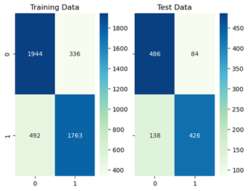
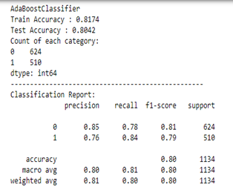
AdaBoost Classifier
An AdaBoost classifier is a meta-estimator that begins by fitting a classifier on the original dataset and then fits additional copies of the classifier on the same dataset but where the weights of incorrectly classified instances are adjusted such that subsequent classifiers focus more on difficult cases.

Slide 31
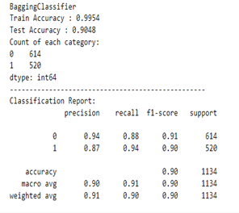
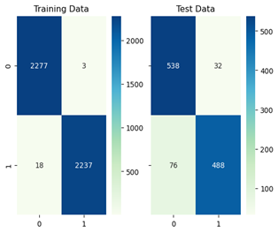
Bagging Classifier:
A Bagging classifier is an ensemble meta-estimator that fits base classifiers each on random subsets of the original dataset and then aggregate their individual predictions (either by voting or by averaging) to form a final prediction.
Such a meta-estimator can typically be used as a way to reduce the variance of a black-box estimator (e.g., a decision tree).

Slide 32
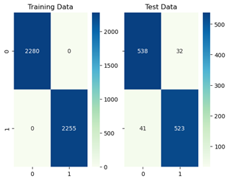
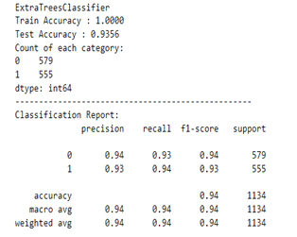
Extra Tree Classifier:
This class implements a meta estimator that fits a number of randomized decision trees (a.k.a. extra-trees) on various sub-samples of the dataset and uses averaging to improve the predictive accuracy and control over-fitting.

Slide 33
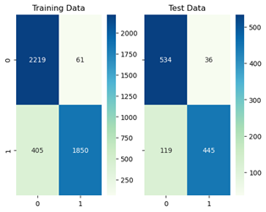
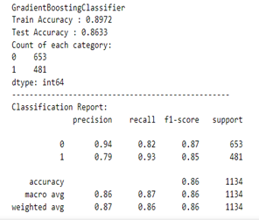
Gradient Boosting Classifier:
Gradient boosting classifiers are a group of machine learning algorithms that combine many weak learning models together to create a strong predictive model. Decision trees are usually used when doing gradient boosting

Slide 34
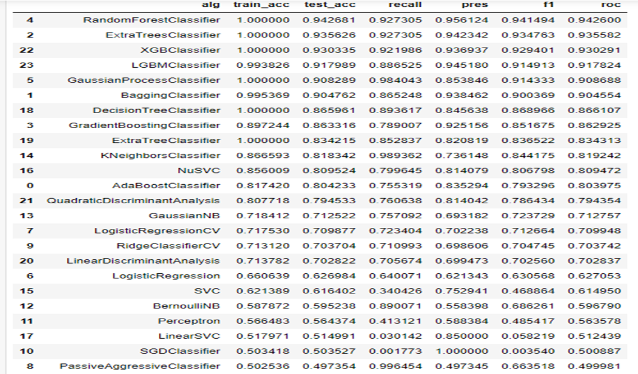
Model Performance

Slide 35
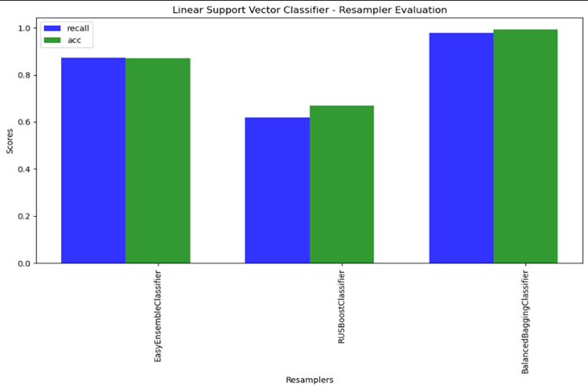
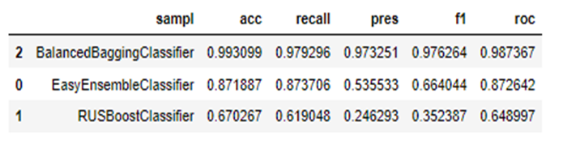
vEasy Ensemble classifier
vBalanced Bagging Classifier
vRUSBoost
Ensemble classifier which have samplers internally

Slide 36
Model Require Scaling:
Logistic Regression
Logistic RegressionCV
PassiveAggressiveClassifier
RidgeClassifierCV
SGDClassifier
Perceptron
GaussianProcessClassifier
SVC

Slide 37
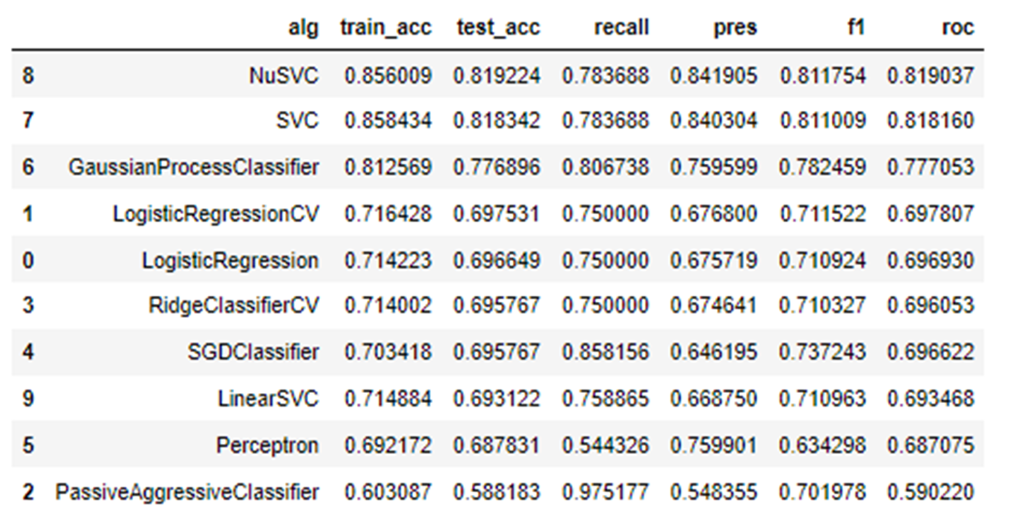
After Using MinMax scaling technique, the performance increased.

Slide 38
Hyper Parameter Tuning:
Hyperparameter tuning using GridSearchCV, RandomSearchCV
GridSearchCV –
Gridsearchcv is the process of performing hyperparameter tunning in order to determine the optimal values for a given model.
GridSearchCV is a function that comes In scikit-learn model selection package .
GridSearchCV tries all combination of the values and evaluated the model for each combination using the cross validation method.
RandomSearchCV-
RandomSearchCV set up a grid of hyperparameter values and select random combination to train model and score. The number of search iterations is set based on time/ resources

Slide 39
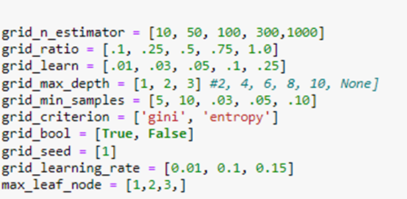
Hyper Parameter Tuning
We have selected: Random Forest Classifier, Extra Tree Classifier,XGB Classifier.
and performed hyper parameter tuning
Grid Parameters

Slide 40
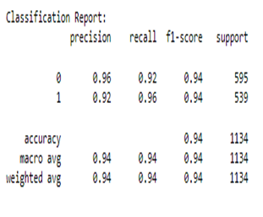
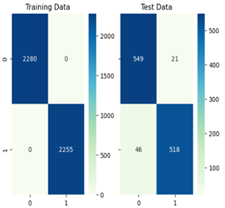
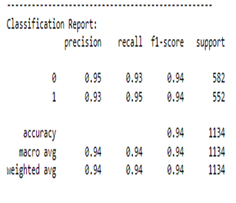
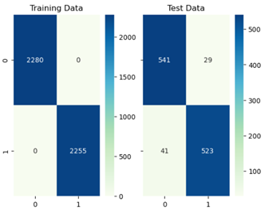
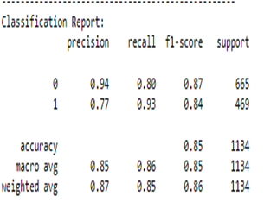

Random Forest Classifier
Extra Tree Classifier
XGB Classifier

Slide 41
Deployment

Slide 42
Deployment using Flask
Flask is a web framework, it’s a Python module that lets you develop web applications easily.
It has a small and easy-to-extend core: it’s a microframework that doesn’t include an ORM (Object Relational Manager) or such features.
It does have many cool features like url routing, template engine. It is a WSGI web app framework.
It was developed by Armin Ronacher, who led a team of international Python enthusiasts called Poocco.
Flask is based on the Werkzeg WSGI toolkit and the Jinja2 template engine.Both are Pocco projects.

Slide 43
Steps required to Deploy Model
Step 1:
Create a “pickle” of the model (i.e. file with an extension as .pkl)
“Pickling” is the process whereby a python object hierarchy is converted in to a byte stream.

Slide 44
Step 2:
Create an HTML page/file with or without CSS which would be the Index page.
One page could be created both to receive the user inputs and display the results or seperate page could be created to receive input and then to display result.
These files should have an extension as “.html” and these files should be stored in the folder “templates”.

Slide 45
Step 3:
Create an file with extension “.py” using python editor like jupyter notebook.

Slide 46
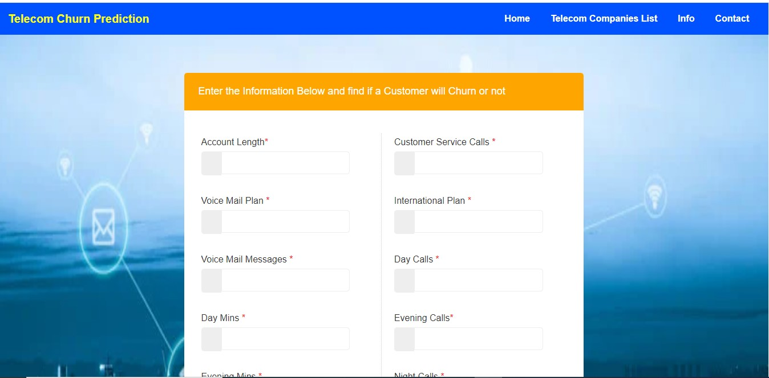
Screenshot of html page.

Slide 47
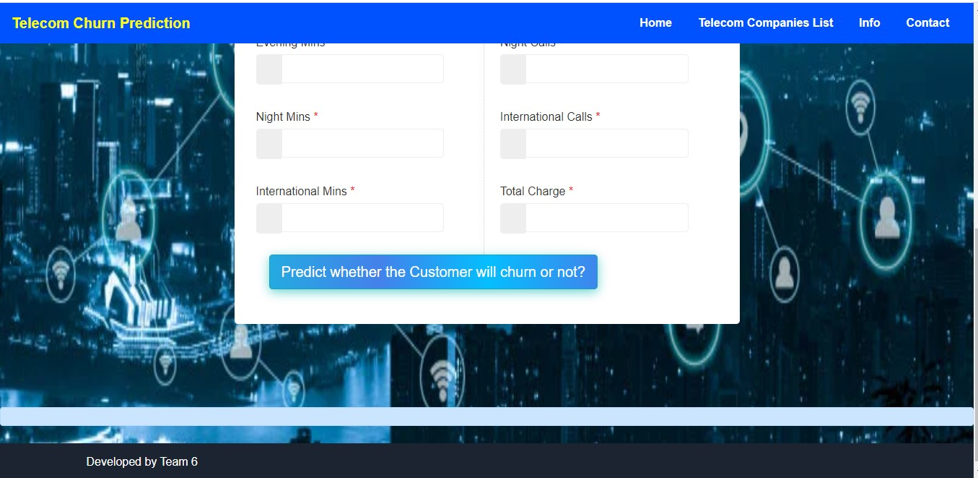

Slide 48
Conclusion:
Final model - Random Forest Classifier.
Performance of the model obtained :
Test Accuracy - 0.940917 (94.09%)
Recall - 0.921986
precision - 0.957643
f1 - 0.939476
roc - 0.940817
Challenges faced during the project:
Time management
Availability of team members
Choosing correct algorithm

Slide 49
How we overcame these challenges:
Discussed and fixed a timeslot suitable for everyone.
divided tasks between the members
Created models for each algorithms and evaluated them based on the performance parameters obtained and selected Random Forest Algorithm as it gave the best performance required

Slide 50
Thankyou

